Slide 1
“How to Tell a True War Story”
Hyperbole & Understatement

Slide 2
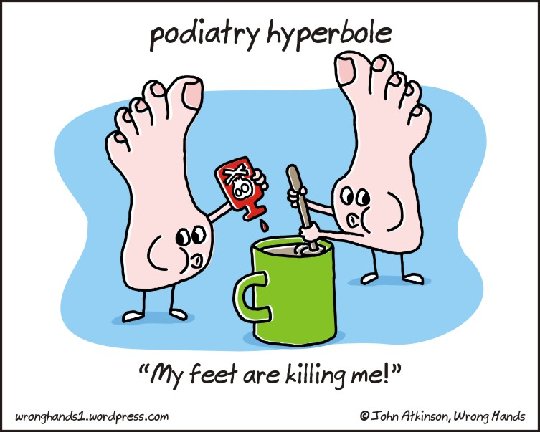
Hyperbole- Makes something seem bigger and more important

Slide 3
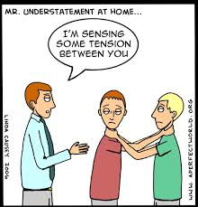
Understatement- Makes something seem smaller and less important than it really is

Slide 4
Two Truths and a Lie
On your piece of paper, write down three things about yourself.
Two out of the three should be completely truthful.
One of them should at least be partially untrue.
BUT you can break the rules if you’d like… They can all be true, they can all be partially true, they can all be complete lies. You decide.
**Please do not share until I ask you to do so.

Slide 5
Ms. Arvizo’s Two Truths and a Lie
I have done about 5 fun runs within the last two years.
I have been to 4 different countries in Europe.
3. I have about 3 sets of grandparents.

Slide 6
Share
Share your three things with the people around you, but don’t tell them which ones are true and which ones aren’t.
Discuss
Does it matter which ones are true and which ones are lies?

Slide 7
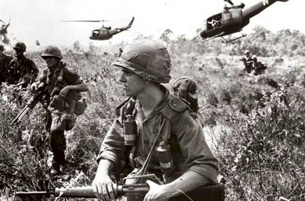
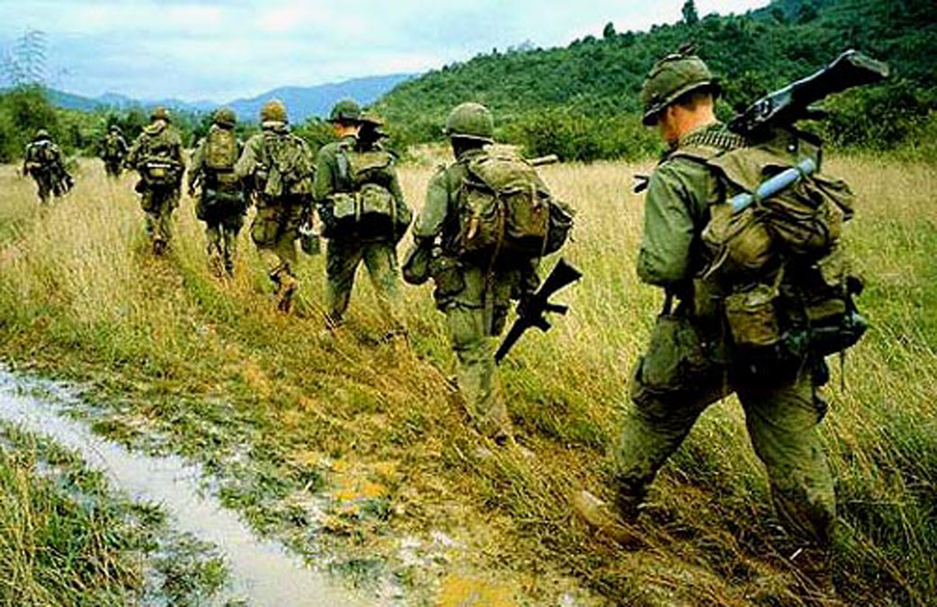
On your piece of paper…
What are war stories usually like? What are some examples that you’ve heard or seen (apart from The Things They Carried)? What are war stories usually about? Are there common themes?

Slide 8
War Montage
As we watch the montage, think about the thematic ideas and patterns you see in these war stories and have seen in war stories in the past. What are they often about?
http://www.youtube.com/watch?v=PvHk15aj3jI&feature=related

Slide 9
In Groups
Read through the pages assigned to your group and write down O’Brien’s criteria for a true war story. That is, what exactly does he say a true war story has to be like?
When you’ve written all of them down from your pages, have someone go write them on the board.
After you write these down, look through your section for hyperbole and/or understatement. Write down your example on a piece of paper and explain it.

Slide 10
Group 1: First couple of pages- “This is true…” to “…cooze never writes back.’” (64-66)
Group 2: Next couple of pages- “The dead guy’s name…” to “… moss and vines and white blossoms.”(66-67)
Group 3: Next few pages (longer section)- “In any war story…” to “… because certain stories you don’t ever tell.”(67-72)
Group 4: Next couple pages- “You can tell a true war story…” to “… makes the stomach believe.”(72-74)
Group 5: Next couple pages- “This one does it for me…” to “… every sin’s real fresh and original.’”(74-76)
Group 6: Next couple pages- “How do you generalize?” to “… nothing is every absolutely true.”(76-78)
Group 7: Next couple- “Often in a true war story…” to “That’s a true story that never happened.”(78-80)
Group 8: Last couple of pages- “Twenty years later…” to “… people who never listen.”(80-81)

Slide 11
Class Discussion
How is our list different from O’Brien’s? How is it the same?
According to O’Brien have you heard a true war story?
What is truth?
Do you believe what he says?
Can any story be true?
Should any story be true?

Slide 12
Your Turn!
Write a short story about a time that you learned an important lesson.
Consider what needs to be true and what doesn’t. Would it take anything away from the story (or the lesson) if it wasn’t completely true?
Include at least one hyperbole and understatement in your story.

