Slide 1
Juxtaposition

Slide 2
First, a quick video…
Pay attention to the term juxtaposition while we watch the video.
Flocabulary Video- Figurative Language

Slide 3
What is juxtaposition?
The following pictures (and the ones at your group) are examples of juxtaposition.
As we look at the pictures, try to come up with a good definition for what juxtaposition is.

Slide 4
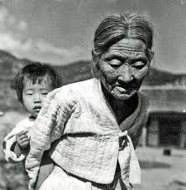

Slide 5
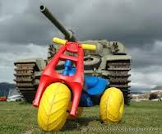

Slide 6
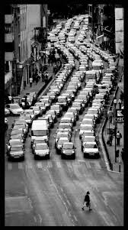

Slide 7
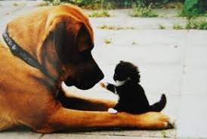

Slide 8
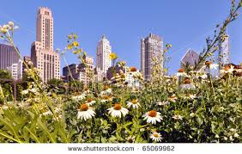

Slide 9
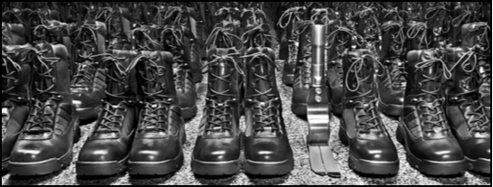

Slide 10
First Response…
Using what you know and the images provided, write your own definition of the term juxtaposition.

Slide 11
Second Response…
Choose ONE of the images to focus on.
On your piece of paper, finish this sentence stem:
The juxtaposition of… and … really makes us think about/see/feel/consider…

Slide 12
Third Response…
What is the impact of juxtaposition?
Write down one word that describes the impact of juxtaposition. When you’re done, stick your word on the board.

Slide 13
Another Video
As we watch this video, consider the impact of the juxtaposition in the video.
Heavyweight

Slide 14
By yourself…
Answer the following questions in complete sentences.
What is the impact of the juxtaposition in the video “Heavyweight”?
Read the first few pages of Sweetheart of the Song Tra Bong in The Things They Carried. What two things are being juxtaposed here? What is the impact so far?

